Slide 1




What Makes A Superhero Marketable
BY Kevin Angotti

Slide 2
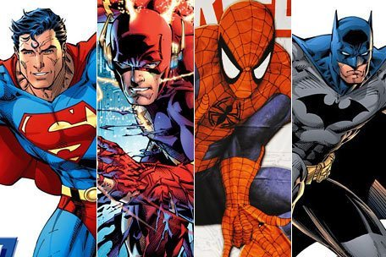
Project Outline
Determine if a superhero can be chosen by examining text information about a list of superheroes.
Hypothesis: Textual data will provide a solid result for choosing a hero(s) from a list.
Will using models like a Natural Language Processing and decision trees be useful in making this kind of selection.
Setting up the project for further analysis; Deep learning, Machine Learning.

Slide 3

Project Details
For this project, I took an approach of wanting to look at how communication companies might go about choosing their next movie or television show based on something other than popularity. We see the same movies and TV shows routinely recycled.
What if these streaming/entertainment companies hired someone to conduct data analysis, with the mindset on choosing the next character to build a platform on. What might this look like, and how can we use analysis to make such a decision.
I found several data sets that provide information based solely on a hero's powers or popularity. That would be just fine if that's all a that was required to be an ideal candidate.
I think there is another way to measure this. You can think about what makes a superhero cool, who is the strongest, who has the best back story, and which character has the best overall abilities.
Answering all or some of these questions can help narrow down available character options, and maybe produce a different result than the typical character you currently see today.

Slide 4
The Data
Data for this project can be found on the Kaggle website, the csv file contained information on over 1400 different superheroes.
The main variables that were highlighted were the power set attributes, which make the main attributes of a hero; these attributes are.
Intelligence
Durability
Strength
Power
Speed
Combat
Cleaning the dataset consisted of removing columns that were not needed and getting rid of NA and NaN values. This also included removing any empty row and column data. I also created a variable called attribute score to measure an overall score based on abilities. The overall score in this dataset is mainly based on popularity and fan voting on the superhero database website.
From this dataset the aim is to analyze the data by the two main text variables, the powers text and, history text.

Slide 5
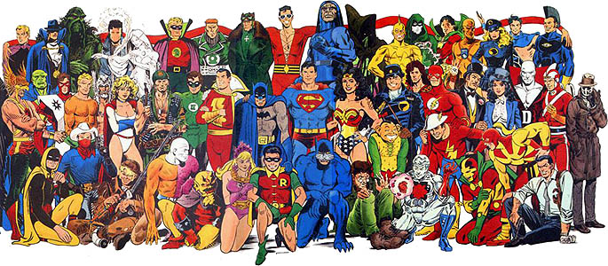
Natural Language Processing
Chosen to transform the two main textual variables from the data set into dictionaries.
This will allow for a few things, first a way to count the frequencies a word returns in the data frame and a way to change the text data into numeric data.
Additional cleaning of the data set will need to be conducted to remove stop words and filter out punctuation.
A concern is that the process will not be able to determine the significance of a word in the description of a superhero's powers or history.

Slide 6
Results of NLP
I was able compound a list of words that I felt were relevant to a heroes description from their history or powers. Some of these included.
Superhuman
Intellect
Skilled
Powerful
Combat/Fighting
Endurance
Enhanced
Expertise
Stealth
Intelligent
Strategy
I also took the entire text variables history and powers and converted them to vectors using the TfidfVectorizer function.
This allowed for a sparsity score to be calculated. The powers variable returned a score of .99 or 99 percent. The history variable returned a score of 1.0 or 100 percent. This tells be that the dictionaries are very large.
The TF IDF results can further be implemented into other models in future applications.

Slide 7
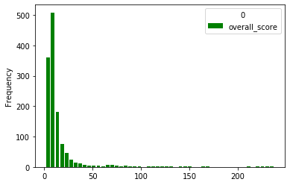
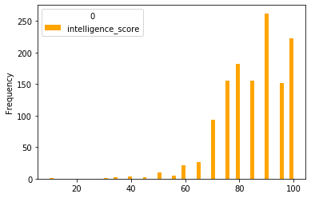
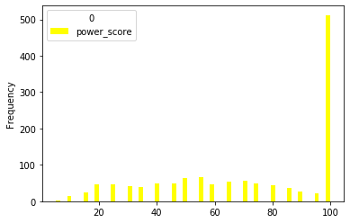
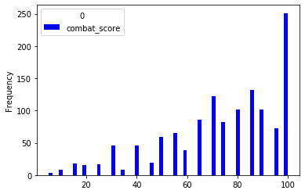
Summary Statistics
A quick look at some summary statistics here shows that the mean for each main power attribute and the overall score variable.
Overall score was 14.56
Intelligence was 82.42
Strength was 41.15
Speed was 48.3
Durability was 58.67
Power was 69.89
Combat was 71.19

Slide 8
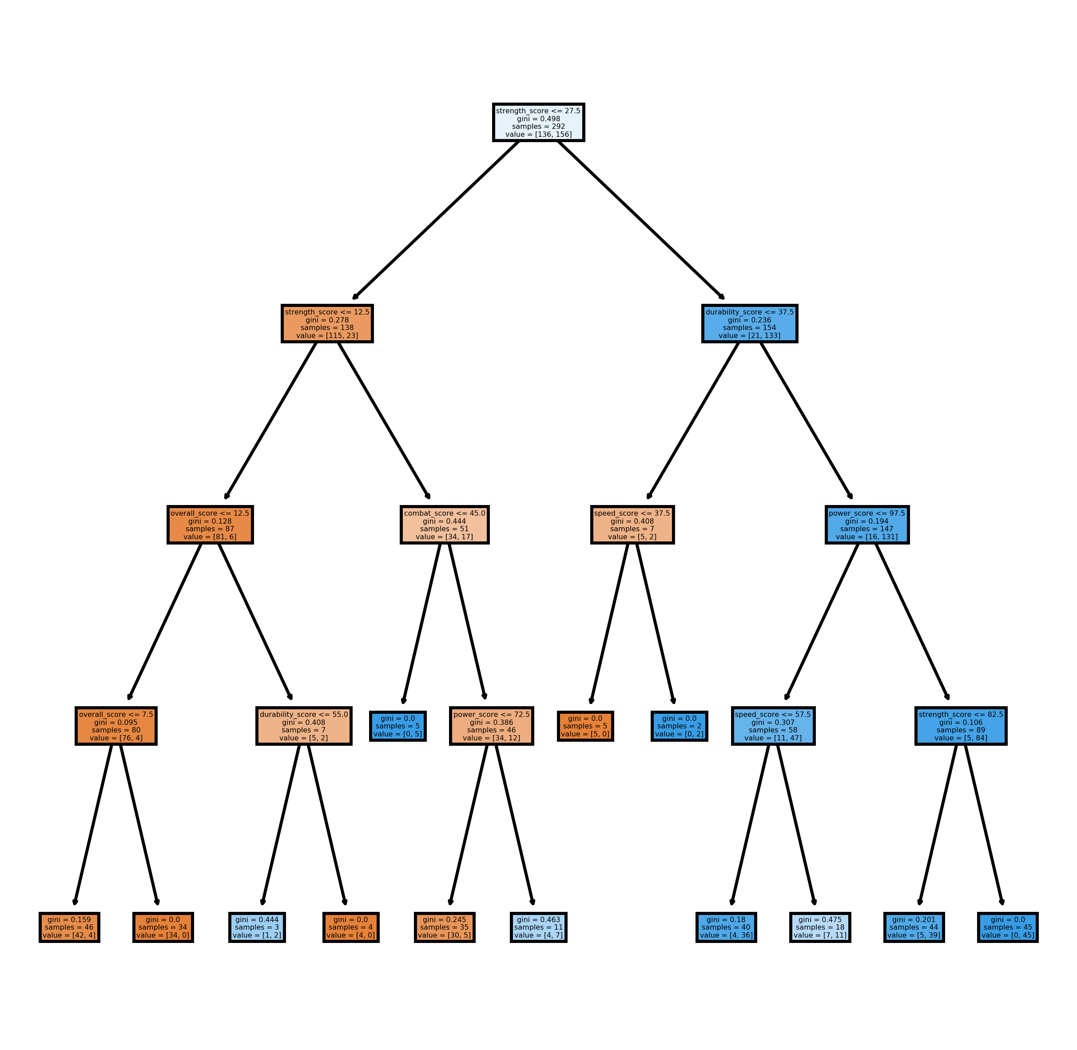
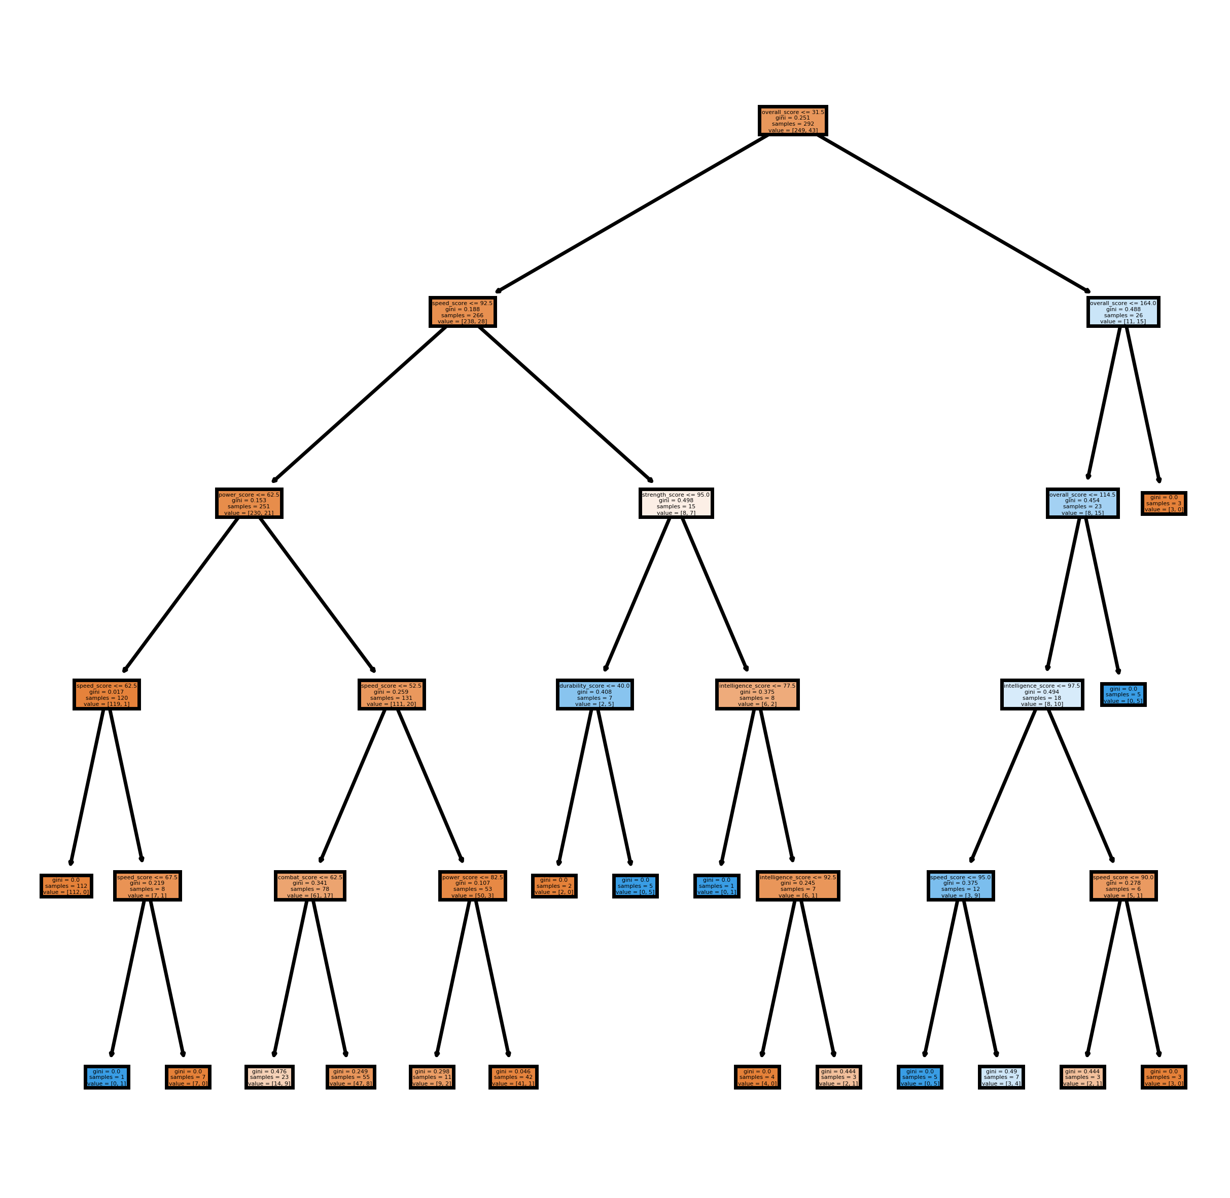
Decision Tree
From the NLP process I was able to take a good amount of returned results and compare that to the variables in my data set. From the 81 variables I was able to filter my data set, and use the results to set up the decision tree model. This will allowed me to look at the power attributes against some characteristic variables.
Some of these variables were,
has_agility, has_stealth, has_energy_absorption, and has_superstrength
I set the tree up with all six attribute scores, the overall score and the created column attribute totals against the target of each characteristic variable I found from the NLP results.
I fund that the has energy absorption and has super strength provided the best outcome for choosing the next character to run with.
Both these models set to depth of at least 4 returned accuracy of .836 or 84% and .851 or 85% respectively.

Slide 9
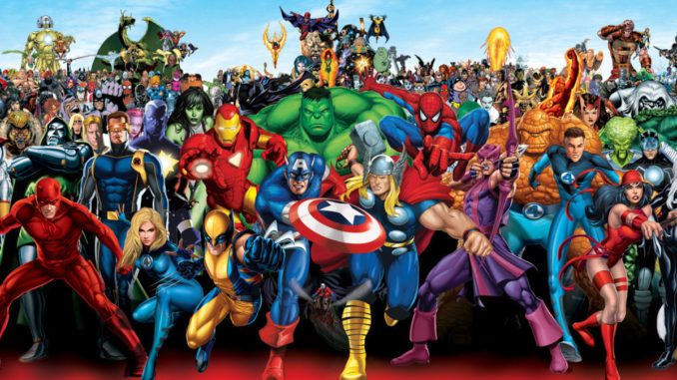
Conclusions
From the text data I was able to narrow down a list of traits that could be implemented into a decision tree.
The resulting tree provided a solid layout to choose a character from. The tree depending on what traits seem appealing to the company could narrow down this particular dataset to a little as 3 samples.
This allows me to accept my hypothesis that textual data can be useful in determining this type of problem.
I believe these results could be further analyzed with other models such as Support Vector Machines or random forests.
Plotting of the NLP vectors would have been ideal, however I was unable to finish that process.
Some future next steps could be to implementation of ML or DL.

